Slide 1

Prompt engineering Process
Notes:
https://console.anthropic.com/settings/plans

Slide 2
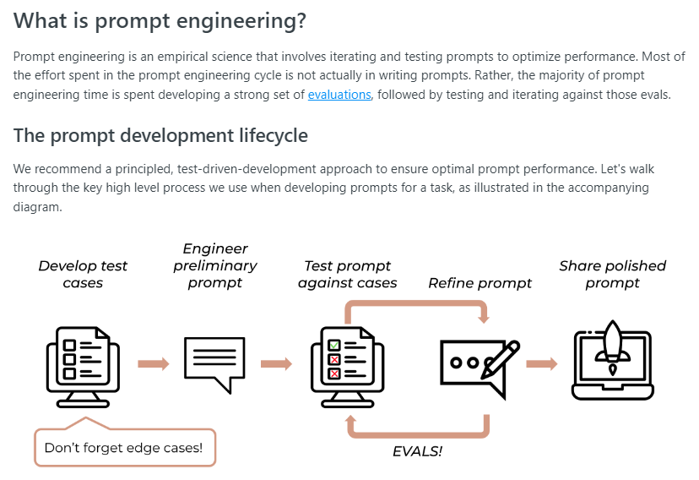
What is Prompt Engineering?
Notes:
https://docs.anthropic.com/claude/docs/prompt-engineering

Slide 3
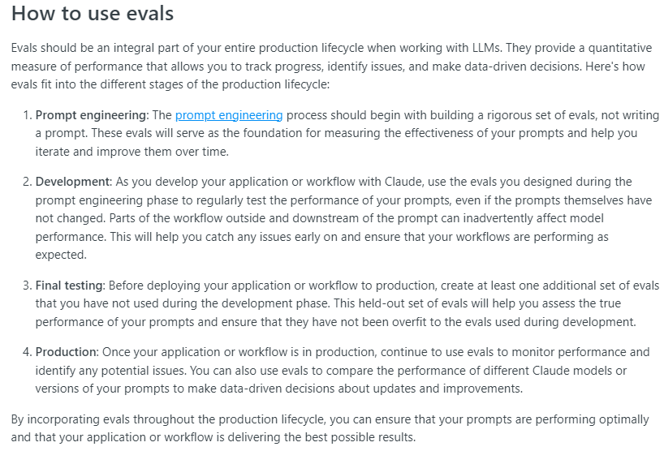
Evaluations: How To use Evals

Slide 4
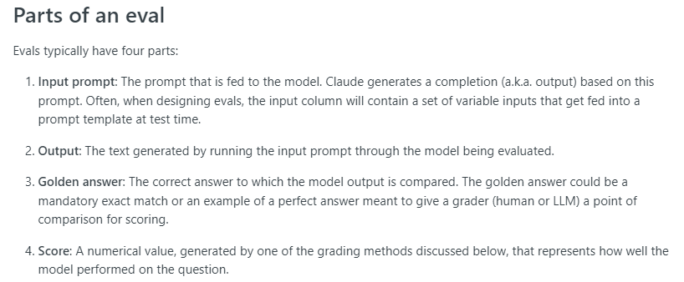
Evaluations: parts of an Eval

Slide 5
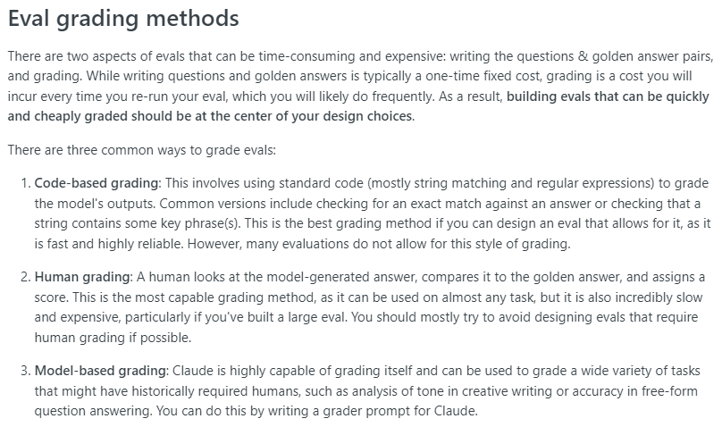
Evaluations: Grading Methods

Slide 6
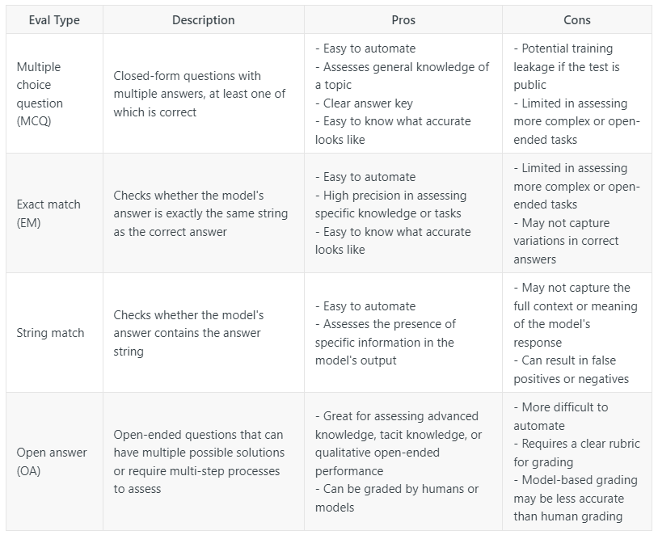
Evaluations: eval Matrix

Slide 7
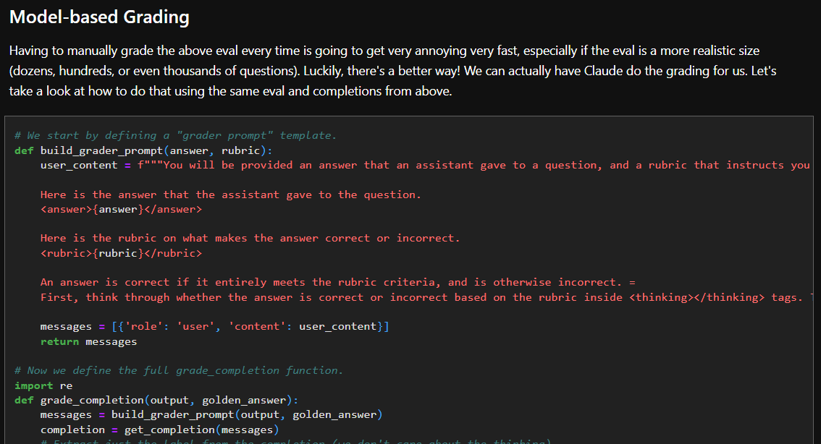
Evaluations: eval cookbook
Notes:
https://github.com/anthropics/anthropic-cookbook/blob/main/misc/building_evals.ipynb

Slide 8
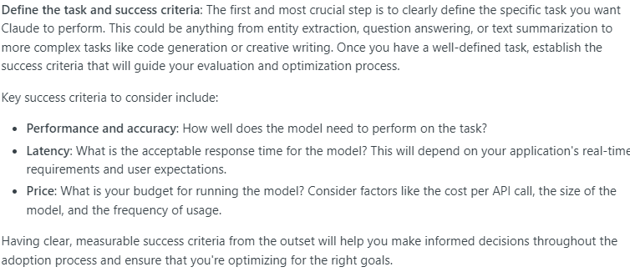
Define Success

Slide 9
Our success Criteria
Take AI research papers as input
Summarize the input in the following way:
Set the reading level to that of a high school student
Give a one paragraph summary
Give 3-5 key points of the paper
Give 3-5 key quotes from the paper

Slide 10
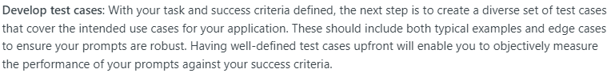
Develop Test Cases

Slide 11
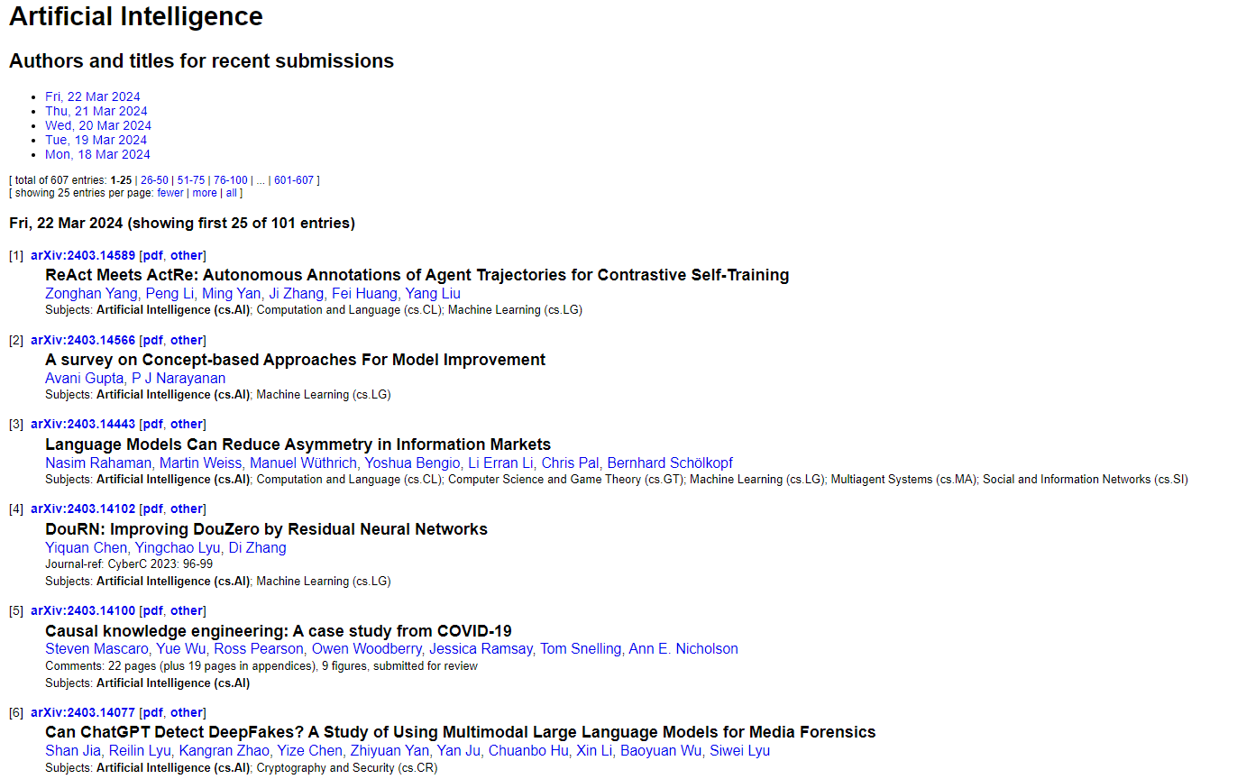
Our Test Cases
Notes:
https://arxiv.org/list/cs.AI/recent

Slide 12
Engineer the initial prompt

Slide 13
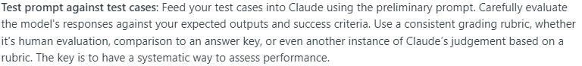
Test the prompt against our test cases

Slide 14
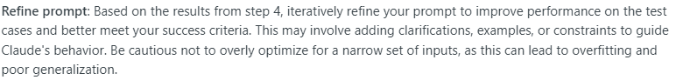
Refine the prompt

Slide 15
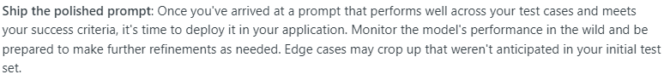
Ship your prompt!

Slide 16
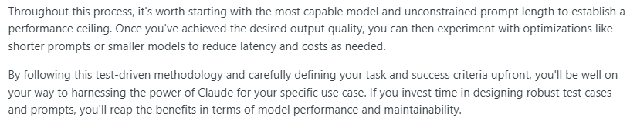
Notes about the process

